Slide 1
NOKUT and the HEIs: external quality assurance in accordance with the ESG
Bishkek, March 10th, 2017
Ole Espen Rakkestad, NOKUT

Slide 2
External quality assurance in Norway
  NOKUT’s two basic forms of EQA:
    accreditation of educational provision
    audit of quality systems/quality work
  all forms are governed by NOKUT’s “Academic Supervision Regulations”

Slide 3
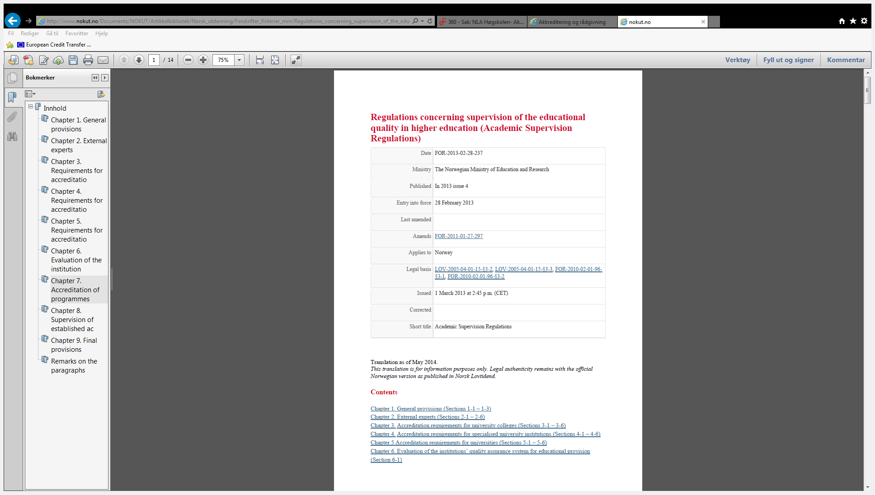
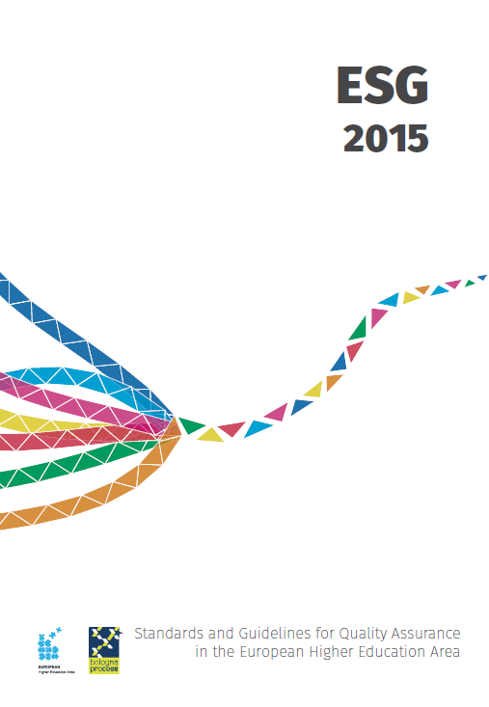
NOKUT’s regulations in context
U&C-act
(national law)
→
←

Slide 4
Accreditation of study programs
Bachelor
Master
PhD

Slide 5
The accreditation process
Additional
Assessment
Decision
Comments on the report
Report draft
Initial
Assessement
Find
Experts
Meeting with Experts
Site Visits

Slide 6
NOKUT-regulations vs ESG
2.4 Peer-review experts
2.3 Implementing processes
2.6 Reporting

Slide 7
NOKUT-regulations vs ESG
ESG 2.4 Peer-review experts
“Standard: External quality assurance should be carried out by groups of external experts that include (a) student member(s).
Guidelines (excerpt): In order to ensure the value and consistency of the work of the experts, they are:
-carefully selected
-have appropriate skills and are competent to perform their tasks
The agency ensures the independence of the experts by implementing a mechanism of no-conflict-of-interest.
The involvement of international experts in external quality assurance, for example as members of peer panels, is desirable (…).” ensure the value and consistency of the work of the experts, they
-- are carefully selected;
-- have appropriate skills and are competent to perform their task;
-- are supported by appropriate training and/or briefing.
NOKUT-regulations, chapter 2 «external experts» (excerpt)
«NOKUT appoints external experts for accreditation (…)»
«For the accreditation of first and second cycle programmes, the external experts shall collectively possess the following expertise:
a) Experts must have competence related to, and experience from, a similar type of program.
b) At least one of the experts must have formal competence at a higher level than the programme under accreditation. (…)”
“Experts must not have any responsibilities at the institution or for the programme they are evaluating or any other disqualifying connection with the institution.”
“c)When assessing second or third cycle programmes, at least one of the experts must have relevant international competence.”

Slide 8

NOKUT-regulations vs ESG
2.6 Reporting
Standard: Full reports by the experts should be published, clear and accessible to the academic community, external partners and other interested individuals. If the agency takes any formal decision based on the reports, the decision should be published together with the report.
NOKUT
All reports are made public and published on NOKUT’s website. Decisions are published together with the reports.

Slide 9
NOKUT-regulations vs ESG
Additional
Assessment
Decision
Comments on the report
Report draft
Initial
Assessement
Find
Experts
Meeting with Experts
Site Visits
2.3 Implementing processes
Standard:
External quality assurance processes should be reliable, useful, pre-defined, implemented consistently and published. They include
-- a self-assessment or equivalent;
-- an external assessment normally including a site visit;
-- a report resulting from the external assessment;
-- a consistent follow-up.

Slide 10
Thank You!

